Slide 1
Data base system
Nasreen Akhtar
FAST-NU
Chiniot Faisalabad Campus

Slide 2
Topic
Data Types
Different Constraints use to create table
DML COMMAND
Insert delete and update operation.
Basic retrieval queries in SQL
SELECT
IN
BETWEEN
EXIST
LIKE
IS NULL

Slide 3
Objectives
How to use SQL to create tables, indexes, and views.
How to use SQL for data manipulation (to Insert , modify, delete, and retrieve data)
How to use SQL to query a database to extract useful information

Slide 4
SQL
SQL is Structured Query Language, which is a computer language for storing, manipulating and retrieving data stored in a relational database.
SQL is the standard language for Relational Database System
All the Relational Database Management Systems (RDMS) like MySQL, MS Access, Oracle, Sybase, Informix, Postgres and SQL Server use SQL as their standard database language.

Slide 5
SQL
1: DDL: Data Definition Language
Create, update, rows column altar, drop table
Constraints define
view create
index create
Command:
Create
Altar
Drop

Slide 6
SQL
2: DML: Data Manipulation Language
Insert
Update
Delete
Select

Slide 7
SQL
Along with Codd’s definition of the relational model, he proposed a language called DSL/Alpha for manipulating the data in relational tables
IBM commissioned a group to build a prototype based on Codd’s ideas.
This group created a simplified version of DSL/Alpha that they called SQUARE. Re-finements to SQUARE led to a language called SEQUEL, which was, finally, renamed SQL.

Slide 8
DML Commands
Data Manipulation Languages include INSERT,DELETE and UPDATE commands.
Use to modify database
INSERT COMMAND
In its simplest form, it is used to add one or more tuples to a relation
Attribute values should be listed in the same order as the attributes were specified in the CREATE TABLE command
Constraints on data types are observed automatically
Any integrity constraints as a part of the DDL specification are enforced
Specify the relation name and a list of values for the tuple

Slide 9

The INSERT Command
Syntax
INSERT INTO TABLE NAME(FIELD1,FIELD2,…..FIELDN)
VALUES(VALUE1,VALUE2,…….VALUEN);
EXAMPLE INSERT INTO EMPLOYEE(Fname, Minit,Lname,SSN,Bdate,Address,Gender,MSSN,Dno) VALUES(‘Richard’,’K’,’Marini’,’653298653’,’1962-12-30’,’98 Oak Forest, Katy, Tx’,’M’,37000,’653298653,4);
OR

Slide 10
The Delete Command
Removes tuples from a relation
Includes a WHERE-clause to select the tuples to be deleted
Tuples are deleted from only one table at a time (unless CASCADE is specified on a referential integrity constraint)
The number of tuples deleted depends on the number of tuples in the relation that satisfy the WHERE-clause
Syntax DELETE from table name WHERE Condition;

Slide 11
The Delete Command
DELETE FROM EMPLOYEE WHERE Lname=‘Brown’;
DELETE FROM EMPLOYEE WHERE SSN=‘123456789’;
DELETE FROM EMPLOYEE WHERE Dno=5;
DELETE FROM EMPLOYEE;
A missing WHERE-clause specifies that all tuples in the relation are to be deleted; the table then becomes an empty table

Slide 12
UPDATE COMMANDS
Used to modify attribute values of one or more selected tuples
A WHERE-clause selects the tuples to be modified
SET-clause specifies the attributes to be modified and their new values
Each command modifies tuples in the same relation
SYNTAX UPDATE TABLE-NAME SET ATRRIBUTE(s)=NEW VALUE WHERE CONDITION;
EXAMPLE UPDATE PROJECT SET Plocation=‘Bellaire’ AND Dnum=5 WHERE Pnumber=10;

Slide 13
BASIC RETRIVAL QUERIES
SELECT
One basic statement for retrieving information from a database
Syntax:
SELECT columnlist FROM tablename;
Columnlist represents one or more attributes, separated by commas
Asterisk can be used as wildcard character to list all attributes.
The WHERE clause is used to extract only those records that fulfill a specified criterion.
Example
SELECT * FROM EMPLOYEE WHERE SSN=123456789;

Slide 14
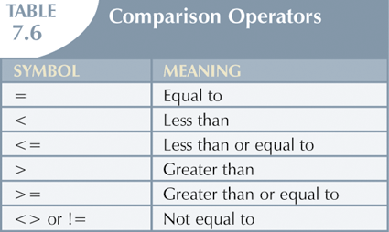
Selecting Rows with Conditional Restrictions

Slide 15
Specific column selection

Slide 16
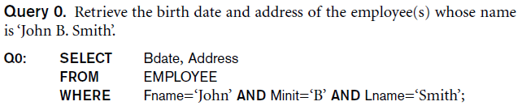
Specific column selection

Slide 17
Specific column selection

Slide 18
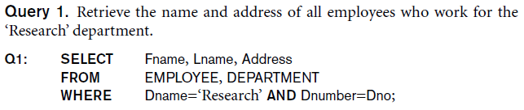
Specific column selection

Slide 19
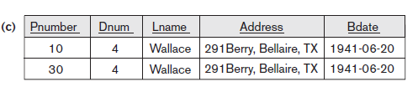


Slide 20
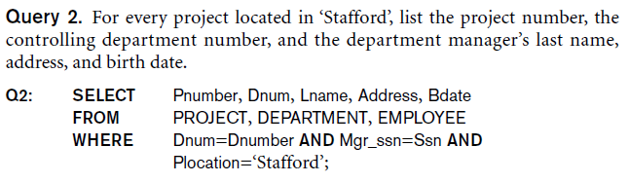

Slide 21
Row selection
1. Select * from EMPLOYEE
Where id=1;
2. Select * from EMPLOYEE
Where Address=‘Lahore’;
3. Select * from EMPLOYEE
Where address=‘Lahore’ AND name=‘Ali’;
4. Select * from EMPLOYEE
Where address=‘Lahore’ OR name=‘Ali’;

Slide 22
SELECT statement
A SELECT statement can consist up to six clauses.
SELECT [DISTINCT | ALL]
{* | [column_expression [AS new_name]] [,...] }
FROM table_name [alias] [, ...]
[WHERE condition]
[GROUP BY column_list]
[HAVING condition]
[ORDER By column_list]
Only SELECT and FROM clauses are mandatory.
Order of the clauses cannot be changed.

Slide 23
SELECT statement
SELECT * FROM EMPLOYEE;
Select * from EMPLOYEE where salary>=25000;

Slide 24
Selecting computed columns
Actual table
City
Year
cars_sold
Dhahran
2001
525
Dhahran
2002
456
Riyadh
2001
700
The name of the computed column in the last slide cab be changed from cars_sold*100000 to sales as follows.
Example:
SELECT
city
,year
,cars_sold As Sold
,cars_sold * 100000 AS sales
FROM car_sales;
Riyadh
2002
654
City
Year
Sold
sales
Jeddah
2001
921
Dhahran
2001
525
52500000
Jeddah
2002
752
Dhahran
2002
456
45600000
Khobar
2002
0
Riyadh
2001
700
70000000
Riyadh
2002
654
65400000
Jeddah
2001
921
92100000
Jeddah
2002
752
75200000
Khobar
2002
0
0

Slide 25
Selecting computed columns
Actual table
City
Year
cars_sold
The name of the computed column in the last slide cab be changed from cars_sold*100000 to sales as follows.
Dhahran
2001
525
Dhahran
2002
456
Riyadh
2001
700
Riyadh
2002
654
Jeddah
2001
921
Jeddah
2002
752
Khobar
2002
0

Slide 26
SQL Clause
DISTINCT CLAUSE:
If a query includes the primary key of a table in its select list, then every row of query results will be unique.
If the primary key is not included in the query results, duplicate rows can occur.
SELECT MGR FROM OFFICES
MGR
----
108
106
104
105
108

Slide 27
SQL Predicates
Different types of predicates are used to retrieve data from tables these are
BETWEEN
IN
NOT IN
LIKE
EXIST
NOT EXIST
IS NULL
NOT NULL
Order by
Group by
Having

Slide 28
SQL Clause
The DISTINCT keyword can be used to return only distinct (different) values.
Syntax SELECT DISTINCT column_name,column_name FROM table_name;
SELCET DISTINCT MGR FROM OFFICE MGR ------------- 104 105 106 108

Slide 29
Special Operators
BETWEEN
Used to check whether attribute value is within a range
Syntax SELECT Columnlist FROM TABLE-Name WHERE Column name BETWEEN(VALUE1 AND VALUE2);
EXAMPLE SELECT * FROM EMPLOYEE WHERE salary>25000 AND salary<55000;
OR
SELECT * FROM EMPLOYEE WHERE salary BETWEEN 25000 AND 55000;

Slide 30
Special Operators
IS NULL
Used to check whether attribute value is null
Example SELECT Fname,LName,Address, salary FROM EMPLOYEE WHERE Address IS NULL;

Slide 31
Special Operators
Wild CARD Character
In SQL, wildcard characters are used with the SQL LIKE operator
SQL wildcards are used to search for data within a table
% substitute for zero or more characters
_ substitute for a single character
LIKE
Used to check whether attribute value matches given string pattern
'%dd%' means a sequence of characters of any length containing ‘dd'.
SYNTAX SELECT COLUMN-NAME(S) FROM TABLE NAME LIKE COLUMN NAME PATTREN;
EXAMPLE SELECT Fname, Lname,Bdate, salary FROM EMPLOYEE where Address LIKE S%;

Slide 32
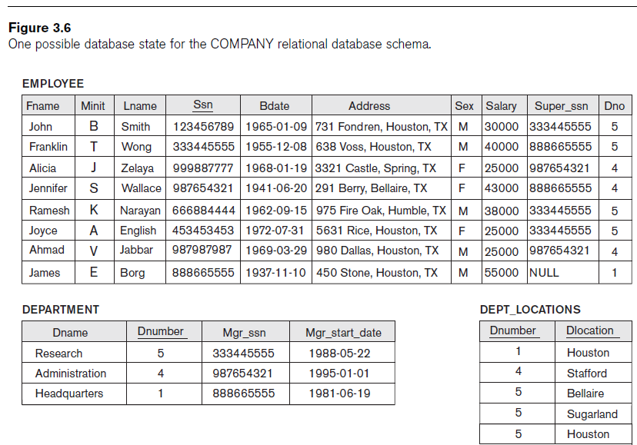
Special Operators
IN
Used to check whether attribute value matches any value within a value list
Syntax SELECT column_name(s) FROM table_name WHERE column_name IN (value1,value2,...);
Example SELECT * FROM EMPLOYEE WHERE salary IN(25000,40000);
NOT IN
Selecting all the records whose column value not a member of the set specified in the WHERE clause.
Example SELECT * FROM EMPLOYEE WHERE salary NOT IN(25000,40000);

Slide 33
SQL Clause
ORDER BY CLAUSE:
The ORDER BY keyword is used to sort the result-set by one or more columns
Keyword DESC to see result in a descending order of values
Keyword ASC to specify ascending order explicitly
SELECT * FROM EMPLOYEE ORDER BY ADDRESS ASC, Fname DESC;
SELECT CITY, REGION, (SALES - TARGET) FROM OFFICES ORDER BY REGION ASC;

Slide 34
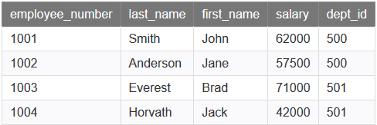

GROUP BY CLAUSE
The SQL GROUP BY clause is used in collaboration with the SELECT statement to arrange identical data into groups.
SYNTAX SELECT column1, column2 FROM table_name WHERE [ conditions ] GROUP BY column1, column2
EXAMPLE SELECT dept_id, SUM(salary) AS total_salaries FROM employees GROUP BY dept_id;

Slide 35
HAVING CLAUSE
The SQL HAVING clause is used in combination with the GROUP BY clause to restrict the groups of returned rows to only those whose the condition is TRUE.
Similar to WHERE, but WHERE filters individual rows whereas HAVING filters groups.
SELECT department, SUM(sales) AS "Total sales" FROM order_details GROUP BY dno HAVING SUM(sales) > 1000;
SELECT DEPARTMENT, MIN(salary) AS "Lowest salary" FROM EMPLOYEE GROUP BY Dnumber HAVING MIN(salary) > 35000;
SELECT DEPARTMENT, MAX(salary) AS "Highest salary" FROM EMPLOYEE GROUP BY Dnumber HAVING MAX(salary) < 50000;

Slide 36
Aggregation Function
ISO standard defines five aggregate functions:
COUNT returns number of values in a specified column.
SUM returns sum of values in a specified column.
AVG returns average of values in a specified column.
MIN returns smallest value in a specified column.
MAX returns largest value in a specified column.

Slide 37
Aggregation Function
Each operates on a single column of a table and return single value.
COUNT, MIN, and MAX apply to numeric and non-numeric fields
SUM and AVG may be used on numeric fields only
Can use DISTINCT before column name to eliminate duplicates.
DISTINCT has no effect with MIN/MAX, but may have with SUM/AVG.
Aggregate functions can be used only in SELECT list and in HAVING clause.
SELECT city, COUNT(*)
FROM car_sales;

Slide 38
Aggregation Function
How many rows are there in the car_sales table?
How many cities are there in the car_sales table?
City
Year
Cars_Sold
SELECT
COUNT(DISTINCT city)
as city
FROM car_sales
Dhahran
2001
525
SELECT COUNT(*) as Rows
FROM car_sales
Dhahran
2002
456
Jeddah
2001
921
Jeddah
2002
752
Rows
city
Khobar
2002
7
4
Riyadh
2001
700
Riyadh
2002
654

Slide 39
SUM Function
Find the total number of all the cars sold from the car_sales table?
Find the number of all the cars_sold in Dhahran from the car_sales table?
City
Year
Cars_Sold
SELECT
SUM(cars_sold) as cars_sold
FROM car_sales
SELECT
SUM(cars_sold) as Dah_cars
FROM car_sales
WHERE city = ‘Dhahran’
Dhahran
2001
525
Dhahran
2002
456
Jeddah
2001
921
Jeddah
2002
752
Cars_sold
Dah_cars
Khobar
2002
4008
981
Riyadh
2001
700
Riyadh
2002
654

Slide 40
MIN,MAX and AVG function
Find the minimum, maximum, and average cars_sold per year and per city form the car_sales table
SELECT MIN(cars_sold) as Min_sold
, MAX(cars_sold) as Max_sold
, AVG(cars_sold) as Avg_sold
FROM car_sales
WHERE car_sales IS NOT NULL;
Min_sold
Max_sold
Avg_sold
456
921
668

Slide 41
Aliasing Table Names
A table alias is created by directly placing an alias after the table name in the FROM clause.
For example in the following example we will refer to departments table as d or dept.
SELECT d.dname
FROM departments d
WHERE d.dno = 1;
SELECT dept.dname
FROM departments dept
WHERE dept.dno = 1;

Slide 42




Nested Queries
Some SQL statements can have a SELECT embedded within them.
A sub select can be used in WHERE and HAVING clauses of an outer SELECT, where it is called a nested query or a subquery.
Who has a salary greater than Abel’s?
Main query:
Which employees have salaries greater than Abel’s salary?
What is Abel’s salary?

Slide 43
SELECT select_list
FROM table
WHERE expr operator
(SELECT select_list
FROM table);
The subquery (inner query) executes once before the main query (outer query).
The result of the subquery is used by the main query.
Example.
SELECT last_name
FROM employees
WHERE salary >
(SELECT salary
FROM employees
WHERE last_name = 'Abel');

Slide 44
Nested queries
From the Lecturer table, select lecturers whose salary is above average
Cannot write 'WHERE salary > avg(salary);
Solution
Select * from lecturer where salary>( select AVG(salary from lecturer);
List the names of all Lecturers who are in the ICS department
select name from lecturer
where dno IN(
select dno from department
where dname=‘ICS’
);

Slide 45
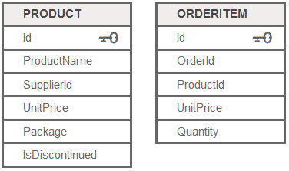
Nested queries
List products with order quantities greater than 100

Slide 46
Nested queries
List products with order quantities greater than 100
select ProductName from PRODUCT
where id=( select id from ORDERITEM
where quantity>100);

Slide 47
Nested queries
Find lecturers whose salary higher than the salary of at least 1 COE lecturer.

Slide 48
Nested queries
Find lecturers whose salary higher than the salary of at least 1 COE lecturer.
Select * from lecturer
Where salary>( select min(salary
from lecturer where dno =(select DNO
from department
where dname=‘COE’)
);

Slide 49
Nested queries
Find lecturers whose salary higher than the salary of every COE lecturer

Slide 50
Nested queries
Find lecturers whose salary higher than the salary of every COE lecturer
Select * from lecturer
Where salary>( select max(salary
from lecturer where dno =(select DNO
from department
where dname=‘COE’);
);

Slide 51
Special Operators
EXISTS
Used to check if subquery returns any rows
Syntax SELECT COLUMN(S) FROM Table-name WHERE EXISTS ( subquery );
EXAMPLE SELCT * FROM EMPLOYEE WHERE EXISTS( SELECT * FROM DEPARTMENT
WHERE EMPLOYEE.Dno=DEPARTMENT.Dnumber);
Find all ICS lecturer SELCT * FROM LECTURER WHERE EXISTS( SELECT * FROM DEPARTMENT
WHERE LECTUREER.Dno=DEPARTMENT.Dnumber AND DNAME=‘ICS’);

Slide 52
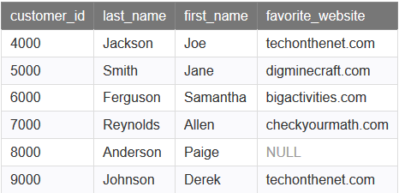
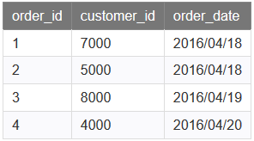
find all of the records from the customers table where there is at least one record in the orders table with the same customer_id.

Slide 53
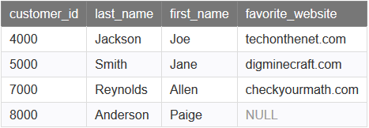
find all of the records from the customers table where there is at least one record in the orders table with the same customer_id.
SOLUTION
SELECT * FROM customers
WHERE EXISTS (
SELECT * FROM orders
WHERE
customers.customer_id = orders.customer_id);

Slide 54
NOT EXISTS Operators
Query: List first and last name of employees who work on ALL projects NOT controlled by Dno=5.
SELECT Fname, Lname FROM Employee WHERE NOT EXISTS ( (SELECT Pnumber FROM PROJECT WHERE Dno=5)) ;
Find all non ICS lecturers.
SELECT *
FROM lecturers a
WHERE NOT EXISTS
(
SELECT *
FROM department b
WHERE a.dno = b.dno
AND b.dname = ‘ICS‘
);

Slide 55

Not Exists
SELECT * FROM customers
WHERE NOT EXISTS (SELECT * FROM orders WHERE customers.customer_id = orders.customer_id);

Slide 56
Not Exists
Find the record of all those customer who doesn’t place any
order

Slide 57
Correlated queries
A correlated subquery is a subquery that uses the values of the outer query. In other words, the correlated subquery depends on the outer query for its values.
Because of this dependency, a correlated subquery cannot be executed independently as a simple subquery.
Moreover, a correlated subquery is executed repeatedly, once for each row evaluated by the outer query. The correlated subquery is also known as a repeating subquery
The main difference between a SQL correlated subquery and a simple subquery is that a SQL correlated subquery references columns from the table of the outer query.

Slide 58
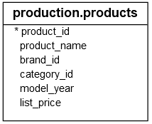
Example 1
Select Product_name.list_price,category_id
From production,product p1
Where list_price IN(
select MAX(p2.list_price)
From production,product p2
where p2.category_id=p1.Category_id
Group by p2.category_id)
order by
Name_list, category_id

Slide 59
Correlated queries
Used to affect row by row processing, each subquery is executed once for every row of the outer query
“It is a sub query that uses the value of outer query
It is top down approach
GET
Candidate row
Execute
Inner query using candidate row values
Use
Value(s) from inner query to qualify candidate row

Slide 60
EXAMPLE 2
“Find the student taking atleast three courses
Nested sub query
Select * from STD where st_id In( Select st id from REGISTERATION
group by st_id
Having count(st-id)>=3)
By correlated queries
Select * from STD where 3>=(select count (st_id) from Registration
where st_id=STD.St_id)

Slide 61
EXAMPLE 2
SELECT po_num, ship_date FROM orders main WHERE 10 > (SELECT COUNT (DISTINCT ship_date) FROM orders sub WHERE sub.ship_date < main.ship_date) AND ship_date IS NOT NULL ORDER BY ship_date, po_num;

Slide 62
EXAMPLE 2
“Find the Faculty who advise atleast one student
By correlated queries
Select * from FACULTY where exist(select * from STD
where f_id=FACULTY.f_id)

Slide 63
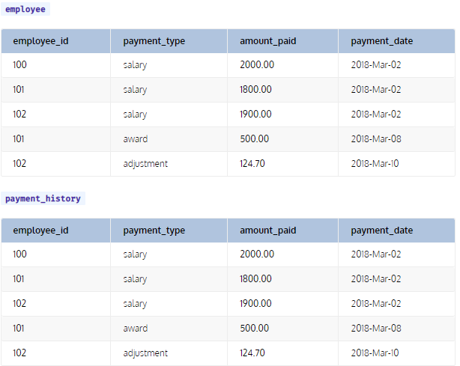
EXAMPLE 2
“Obtain the names of employees who never received an award”
SELECT last_name, first_name
FROM employee e1
WHERE NOT EXISTS (SELECT ph.last_name
FROM payment_history ph
WHERE ph.employee_id = e1.employee_id
AND ph.payment_type = 'award')

Slide 64
Corelated Queries
“It is a sub query that uses the value o outer query
It is top down approach
SELECT last_name, first_name
FROM employee e1
WHERE NOT EXISTS (SELECT ph.last_name
FROM payment_history ph
WHERE ph.employee_id = e1.employee_id
AND ph.payment_type = 'award')

